Slide 1
DURHAM COLLEGE Final Project Submitted By: Sonymon Chirakkadavil Joseph

Slide 2
SUMMARY OF THE PROBLEMS
In this final project, I am required to analyze 60 observations and 6 variables to identify the best model for predicting students’ changes in standardized scores after training. I will compare the performance of three models: Naïve Bayes, Logistic Regression, and Neural Network.
The following steps will be addressed before making a conclusion:
Plot a correlation heatmap to explore relationships between variables and explain the key insights derived from the heatmap.
Present a pair plot to visually examine the distributions and interactions among variables and explain the key insights observed.
Present the confusion matrix and classification report for each of the three models. Analyze and explain the strengths and limitations of each model based on these metrics.
After evaluating the results of all three models, recommend the most accurate model for predicting changes in students’ standardized scores.
Propose two improvements that could increase the usability and performance of the chosen model.

Slide 3
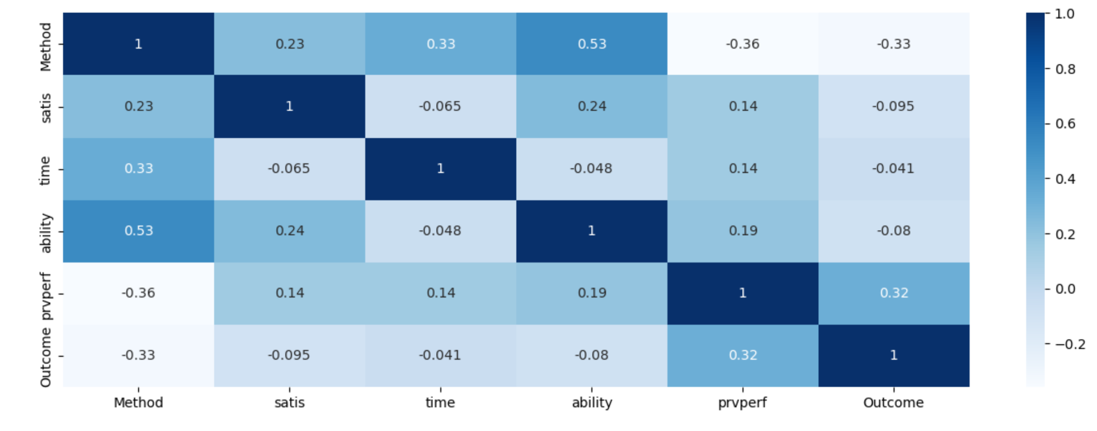
CORRRELATION HEAT MAP

Slide 4
KEY INSIGHTS- CORRELATION HEAT MAP
1.Positive Correlation:
It is clear from the heat map that there will be a positive correlation(0.53) between Method and ability and it is obvious that when the teaching method increases ability score is also increasing. In conclusion, when the training method increases students ability to score also increases.
2.Negative Correlation:
There will be a Negative Correlation(-0.36) between Method and Previous Performance(prvperf) which indicate that when the method score increases the score of prvperf is decreasing. In general, students with lower previous performance are more likely to be assigned higher-method scores.

Slide 5
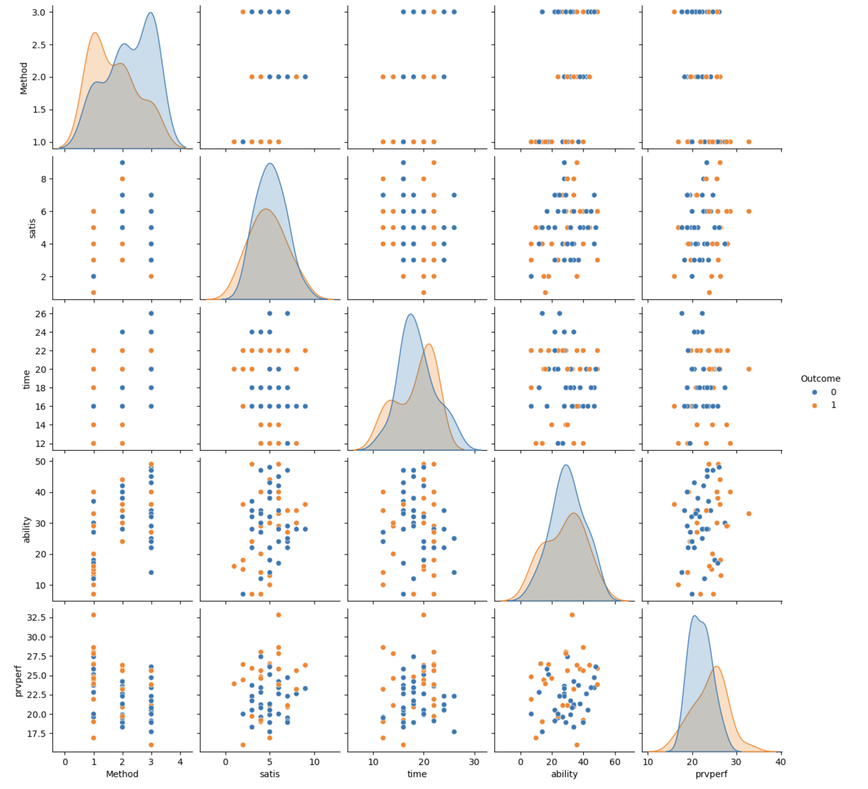
.
.
PAIR PLOT VISUAL

Slide 6
.
.
KEY INSIGHTS- PAIR PLOT
Ability is the Strongest Predictor:
The orange curve, which represents students that made progress, is primarily concentrated in the higher ability range (~35–60) in the pair plot. Most students in the blue category have lower ability scores (~15–35).
2.Previous Performance Boosts Predictability:
The previous performance scores of students who improved are often higher range (~28–32), whereas those who did not improve are typically between 20 and 26.

Slide 7
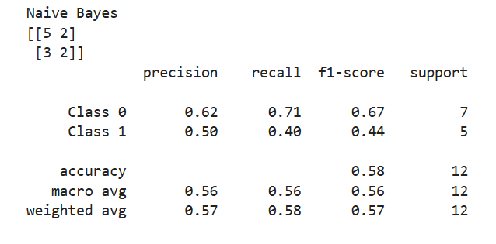
.
CONFUSION/CLASSIFICATION REPORTS OF THREE MODELS
NAÏVE BAYES

Slide 8
.
CONFUSION/CLASSIFICATION REPORTS OF THREE MODELS
1.Naïve Bayes:
a)Precision: It is clear that the precision value of Class 0 is 0.62 which indicate that model is 62% correct when it predicts the outcome. In conclusion When the model predicted a student had a negative change after training, it was correct 62% of the time. Also, in the case of Class 1 the precision value is 0.50 which means when the model predicts student’s have a positive change after training only 50% of prediction is correct.
b)Recall: The Recall value of Class 0 is 0.71 which is greater than Class 1 recall value(0.40) which indicate that the model is accurate when predicting students have a negative change of previous score after training.
c)F1-Score:The F1-score of Class 0 is 0.67 and it is higher than Class 1 which is 0.44 and it is a clear indication that student’s doesn’t have the improvement after training. the higher value of F1-Score is important because it ensure a balanced and fair evaluation of the model, and it gives a better balance between precision and Recall.

Slide 9
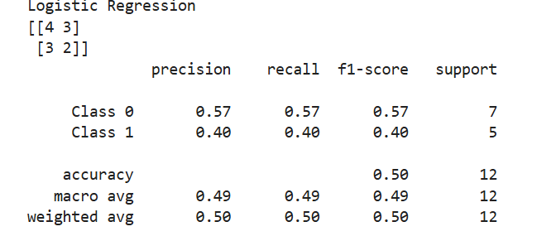
.
CONFUSION/CLASSIFICATION REPORTS OF THREE MODELS
LOGISTIC REGRESSION

Slide 10
.
CONFUSION/CLASSIFICATION REPORTS OF THREE MODELS
2.Logistical Regression:
1.Precision:The precision value for Class 0 stands at 0.57 indicating that predictions made by the model achieve 57% accuracy. Based on predictive modeling when the system forecasted that students would demonstrate negative learning improvements after training it proved correct 57% of the time. The precision value of Class 1 reveals that the model correctly predicts positive change among students during training at a rate of 40%.
2.Recall:The Recall value for Class 0 greater than the value for Class 1 (0.57 > 0.40) indicating more accuracy in predicting students with negative score change after training.
3.F1 Score: The F1-Score of Class 0 achieves 0.57 while Class 1 attains 0.40 indicating that students showed no improvement during training. F1-Score maintains importance because it establishes fair evaluation combined with precision and recall measures.

Slide 11
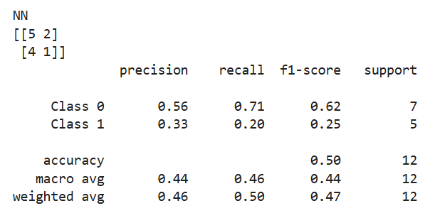
.
CONFUSION/CLASSIFICATION REPORTS OF THREE MODELS
NEURAL NETWORK

Slide 12
.
CONFUSION/CLASSIFICATION REPORTS OF THREE MODELS
3.Neural Network:
1.Precision:The prediction accuracy rate for Class 0 amounts to 0.56 which demonstrates that the model correctly predicts results with 56% precision. The forecasting model achieved accurate results in 56% of cases where students would show negative learning improvements following training. The precision value shows that the model correctly predicts student training-related positive changes to occur at a 33% success rate.
2.Recall:The Recall value for Class 0 showed better predictive ability than Class 1 because it exceeded its value (0.71 > 0.20) which results prediction of negative impact of score after training is higher than positive effect.
3.F1-Score:The trained students failed to show improvement as Class 0 F1-Score reached 0.62 while Class 1 scored 0.25. F1-Score functions as an important performance indicator since it offers balanced evaluation based on precision and recall metrics.

Slide 13
.
RECOMMENDATION OF THE MODEL
After comparing Accuracy,Precision,Recall,F1 Score and Support from the three models I would recommend Naïve Bayes model for the use.Following are the reasons for choosing this model.
1.Accuracy:Naive Bayes achieved the highest accuracy (58%) compared to other two both Logical Regression and Neural Network have accuracy is about 50%.
2.Performance:The precision and Recall value of Naïve Bayes model surpasses other 2 models indicating better prediction abilities while Neural Network model shows a Recall value of 0.20 which is significantly lower than the 2 other models.
3.F1 Score Superiority: The F1-score shows superiority by balancing precision with recall throughout macro and weighted average calculations.
The Naive Bayes model stands out as the best choice because it presents superior overall testing performance and better data generalization capabilities. The enhancement stands as a marginally significant advantage that surpasses alternative models.

Slide 14
.
POSSIBLE IMPROVEMENTS OF THE MODELS
Following are the 2 possible improvements demanding for the model for the better prediction and usability.
1.Probability Calibration:
If the model can apply Probability Calibration techniques like Platt scaling or isotonic regression the model would be better compared to other models also Naive Bayes generates probability scores that present themselves with excessive confidence. Realistic confidence levels derived from calibrated model assessment enable better decision-making especially when dealing with risk-sensitive tasks.
2. Dimensionality Reduction:
The Naive Bayes model becomes negatively affected by high levels of noise. The model achieves higher accuracy and operates at increased speed when methods are applied to decrease the number of features it needs to process.
Three techniques namely PCA (Principal Component Analysis), LDA (Linear Discriminant Analysis), and feature selection (with chi-squared test as an example) enable users to eliminate features which do not contribute value to the analysis.

Slide 15
THANK YOU

